Slide 1
Taking the Pulse of Yellowstone’s “Breathing” Caldera
Seismicity
Notes:
This presentation has links to extra content embedded in the slides – best viewed in Presentation Mode!
This presentation focuses on the earthquakes in the Yellowstone region. First, you will view a short general video about volcanoes and hydrothermal features. To watch it, click anywhere on this slide. Then, you’ll examine a few maps to see where Yellowstone National Park is and its significant features—geological as well as practical ones like roads and villages. Finally, you’ll learn more about earthquakes in Yellowstone (its “seismicity”) while your teammates learn more about its volcanic history and hydrothermal systems.
The link to the video takes you to the American Museum of Natural History’s Science Bulletin: “Monitoring the Fire Below.” https://www.youtube.com/watch?v=rFe-VSf-TQ8 Retrieved 5 November 2014. (Search for “monitoring fire below youtube.”)

Slide 2
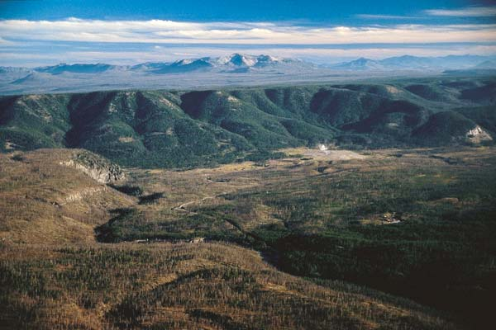
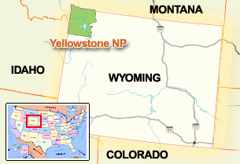
Where is Yellowstone?
Notes:
Yellowstone lies partially in three states -- Montana, Idaho and Wyoming.
Much of Yellowstone is a large crater (a “caldera”) that is surrounded by cliffs. The cliffs are topped by lava flows. This picture was taken from the top of a lava flow. The green bluffs below the mountains are the rim of the caldera. In the foreground are two lava flows.
Photo by Bob Smith, University of Utah. Accessed from National Science Foundation: Discovery. “Yellowstone Rising.” http://www.nsf.gov/discoveries/disc_images.jsp?cntn_id=110651&org=NSF Retrieved 27 December 2011.
Map from National Park Service: “Yellowstone Location Map.” http://www.nps.gov/features/yell/interactivemap/yelllocationmap.htm Retrieved 27 December 2011.

Slide 3
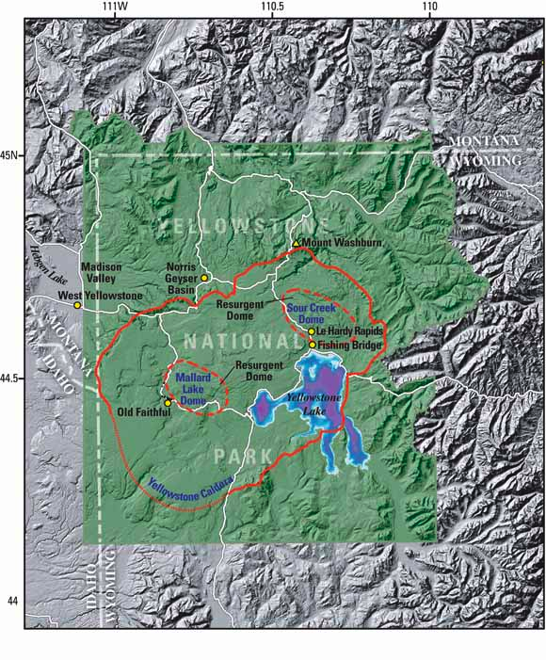
What is Yellowstone?
Exploring the landscape
Notes:
This image shows that the region is mountainous, but there is more subdued topography within most of the national park. The Yellowstone caldera, 640,000 years old, appears as a red-orange line. Where the line is thinner, geologists can only infer the caldera boundary. Volcanic material has filled the caldera and smoothed out the topography. Two later episodes of volcanism pushed up domes within the caldera: the Mallard Lake Dome and Sour Creek Dome.
The squiggly white lines are paved roads.
If you are doing this assignment with a paper map and transparent overlays instead of Google Earth, this map or the one on the next slide could serve as your base map. Your team of three experts will need to decide which map you will use. If you are using paper maps, you have a copy of the two maps in your instructions.
Image from USGS Fact Sheet 100-03. 2004. “Tracking Changes in Yellowstone‘s Restless Volcanic System.” http://pubs.usgs.gov/fs/fs100-03/index.html#yellowstone_fig2 Retrieved 27 December 2011.

Slide 4
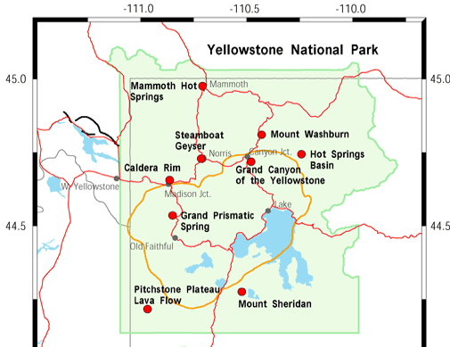
What is Yellowstone?
Exploring the landscape
Notes:
This map of Yellowstone shows roads as red lines and the location of the most recent caldera as a gold line. The park is the green area.
Red dots are links to photos and information about the park from the Yellowstone – Teton Epicenter’s “Location Map.”
By clicking anywhere on the slide, you will open the webpage with live links on the red dots. http://www.yellowstonegis.utah.edu/maps/index.html. (Search for “yellowstone gis epicenter” and choose the maps link.
Image from Yellowstone – Teton Epicenter: “Location Map.” http://www.yellowstonegis.utah.edu/maps/index.html Retrieved 28 December 2011.

Slide 5
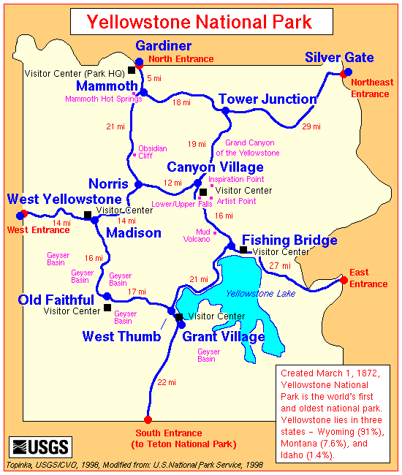
What is Yellowstone?
Cultural and geological features
Notes:
This general map shows where some of the geological and cultural or tourist attractions are. These are where many visitors stop to look at sights, buy supplies, or stay the night. The next map shows more detail.
Map from USGS Cascade Volcano Observatory. http://vulcan.wr.usgs.gov/Imgs/Gif/Yellowstone/Maps/map_yellowstone.gif Retrieved 28 December 2011.

Slide 6
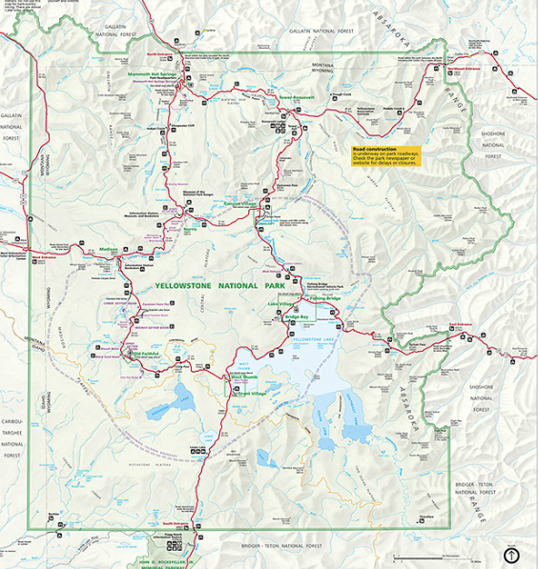
What is Yellowstone?
Cultural and geological features
Notes:
This map shows details that you might want to refer to when learning your part of the geology. It is part of the map/brochure that the National Park Service gives visitors as they enter the park. You can view this map better by clicking anywhere on the map and then being patient….there’s a lot of data to open. http://www.nps.gov/hfc/carto/PDF/YELLmap1.pdf (Search for “Yellowstone detail yellmap1.”)
The base map that you will draw on is a simplified version of this map.
Image from National Park Service: Park Map Viewer. http://www.nps.gov/pwr/customcf/apps/maps/showmap.cfm?alphacode=yell&parkname=yellowstone%20national%20park Retrieved 28 December 2011.

Slide 7
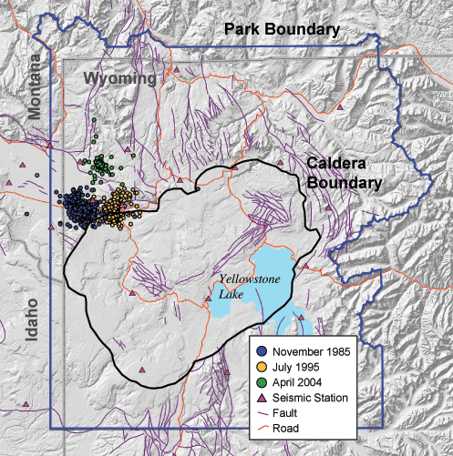
Taking Yellowstone’s Pulse Earthquakes
Earthquake swarms
Notes:
Earthquake swarms from 1985 to 2004 are shown on this map. Colored dots stand for different periods of time, as shown in the key. The black line marks the caldera boundary.
Map from Yellowstone Volcano Observatory: Yellowstone Earthquake Swarms.
http://volcanoes.usgs.gov/yvo/publications/2004/apr04swarm.php Retrieved 30 December 2011.

Slide 8
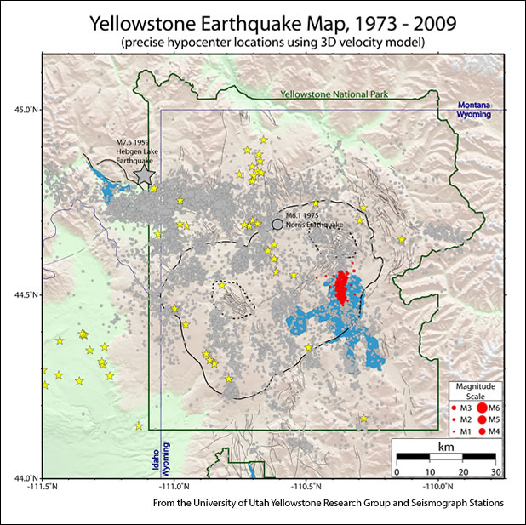
Taking Yellowstone’s Pulse Earthquakes
36 years of earthquakes
Notes:
This map shows the locations of earthquake epicenters. In the 36 years of records shown here, there have been only 2 major earthquakes:
7.5 Hebgen Lake earthquake, marked with a grey star; and
6.5 Norris Geyser Basin, marked with a large grey circle.
Red circles mark earthquakes that occurred in a swarm in 2008. Small grey circles mark other earthquakes. Yellow stars are volcanic vents.
Map from Yellowstone Volcano Observatory: More Yellowstone Lake Earthquake Swarm Images. http://volcanoes.usgs.gov/yvo/publications/2009/moreswarm.php Retrieved 30 December 2011.

Slide 9
Taking Yellowstone’s Pulse Student resources
Other resources:
Data
Recent earthquake activity (7 day)
http://www.seis.utah.edu/req2webdir/recenteqs/Maps/Yellowstone.html (Search for “recent earthquakes yellowstone.”)
Live seismograms
http://quake.utah.edu/helicorder/yell_webi.htm (Search for “earthquake helicorder yellowstone.”)
Notes:
Use these links to update your maps with the most recent earthquake information.

Slide 10
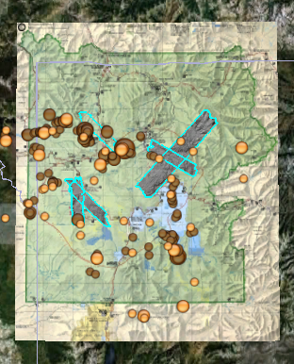
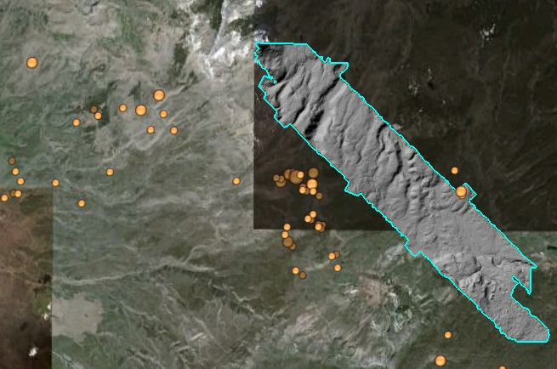
Taking Yellowstone’s Pulse Earthquakes
Earthquakes in Google Earth
Notes:
If your team will be using Google Earth (GE) to compare where the interesting features in the park are, you might want to become familiar with your data on GE now. These two images were made with GE. The left-hand one shows all of the park, with an overlay of the National Park Service map, dots for the largest earthquakes, and turquoise outlined areas of high-tech satellite based topography (LiDAR).
The right-hand image is zoomed in on the west side. You can see where it’s from by the northwest-southeast trending LiDAR region. This image does not have the official park map showing, just the base map, the earthquakes, and LiDAR. You’ll be able to add layers and remove them easily in GE.
There is a separate set of instructions which guide you through using Google Earth. Also, we have prepared some files that are ready for you to open in GE. (You can also make your own files from a spreadsheet by following our instructions.) The next slide has links to these files.

Slide 11
Taking Yellowstone’s Pulse Data
Links to data files:
Yellowstone’s 200 most recent earthquakes (as of January 2012)
Yellowstone’s 200 largest earthquakes
Earthquakes from the last week
The National Park Service map as an overlay
Satellite images of the ground (LiDAR)
Links to instructions:
Instructions for using Google Earth
Instructions for converting an Excel spreadsheet into a file for Google Earth
Notes:
Both images were clipped from the same GE maps as on the previous page.

Slide 12
Taking Yellowstone’s Pulse Student resources
Other resources:
Information
Learn about the 2008 earthquake swarm at Yellowstone lake
http://volcanoes.usgs.gov/yvo/publications/2009/09swarm.php (Search for “usgs 2009 swarm.”)
Learn about the 2010 earthquake swarm at Madison Plateau
http://volcanoes.usgs.gov/yvo/publications/2010/10swarm.php (Search for “2010 swarm madison.”)
Learn about Yellowstone's earthquakes and volcanoes (Geology chapter).
http://www.nps.gov/yell/planyourvisit/resourceandissues.htm (Search for “nps yellowstone resources.”)
Learn from National Geographic about the Yellowstone supervolcano and earthquakes.
http://ngm.nationalgeographic.com/2009/08/yellowstone/achenbach-text (Search for “achenbach yellowstone.”)
Notes:
You can use these links to update your maps with the most recent earthquake information.
You can learn about the role that EARTHSCOPE is playing in monitoring the Yellowstone volcano by going to http://www.earthscope.org/es_doc/onsite/onSite_spring09.pdf.

Slide 13
Taking Yellowstone’s Pulse Sources
American Museum of Natural History (n.d.) Science Bulletins: “Yellowstone: Monitoring the Fire Below, “Signs of Restlessness.” http://www.amnh.org/explore/science-bulletins/earth/documentaries/yellowstone-monitoring-the-fire-below/article-signs-of-restlessness (Search for “amnh signs restlessness.”)
Christensen, R. et. al.2007. USGS: Open-file Report 2007-1071. “Preliminary Assessment of Volcanic and Hydrothermal Hazards in Yellowstone National Park and Vicinity.“ http://pubs.usgs.gov/of/2007/1071/ (Search for “preliminary volcanic hydrothermal hazards yellowstone.”)
Dzurisin, D.; Savage, J.C.; and Fournier, R.O. 1990. “Recent crustal subsidence at Yellowstone Caldera, Wyoming.” Bulletin of Volcanology, v. 52, p. 247-270. accessed from Yellowstone Volcano Observatory,“ Leveling Data Across Yellowstone Caldera.” http://pubs.er.usgs.gov/publication/70016303 (Search for “recent subsidence at yellowstone.”)
Puckas, C.; Smith, R; Meertens, C.; and Chang, W-L. 2007. “Crustal deformation of the Yellowstone-Snake River Plain volcano-tectonic system: Campaign and continuous GPS observations, 1987-2004.” Journal of Geophysical Research, v. 112. http://volcanoes.usgs.gov/yvo/2007/PuskasJGR.pdf (Search for “Puskas deformation yellowstone-snake river.”)
USGS. 2010. Yellowstone Volcano Observatory. “Volcano Monitoring at Yellowstone National Park” http://volcanoes.usgs.gov/yvo/activity/monitoring/index.php (Search for “YVO monitoring.”)
USGS. 2008. Yellowstone Volcano Observatory. “Recent ups and downs of Yellowstone Caldera.” http://volcanoes.usgs.gov/yvo/publications/2007/upsanddowns.php (Search for “ups downs yellowstone.”)
USGS. 2005. U.S. Geological Survey Fact Sheet 2005-3024: “Steam Explosions, Earthquakes, and Volcanic Eruptions--What’s in Yellowstone’s Future?” http://pubs.usgs.gov/fs/2005/3024/ (Search for “usgs steam explosions yellowstone.”)
USGS. 2004. U.S. Geological Survey Fact Sheet 100-03: “Tracking Changes in Yellowstone’s Restless Volcanic System.” http://pubs.usgs.gov/fs/fs100-03/ (Search for “tracking changes yellowstone.”)
Notes:
All retrieved 6 November 2014.

