Slide 1
Taking the Pulse of Yellowstone’s “Breathing” Caldera
Eruption History
Notes:
This presentation has links to extra content embedded in the slides – best viewed in Presentation Mode!
This presentation focuses on the eruption history of the Yellowstone region. First, you will view a seven minute video about volcanoes and hydrothermal features. To watch it, click anywhere on this slide. Then, you’ll examine a few maps to see where Yellowstone National Park is and its significant features—geological as well as practical ones like roads and villages. Finally, you’ll learn more about the history of eruptions in Yellowstone while your teammates learn more about earthquakes and hydrothermal systems.
The link to the video takes you to the American Museum of Natural History’s Science Bulletin: “Monitoring the Fire Below.” https://www.youtube.com/watch?v=rFe-VSf-TQ8 Retrieved 5 November 2014. (Search for “monitoring fire below youtube.”)

Slide 2
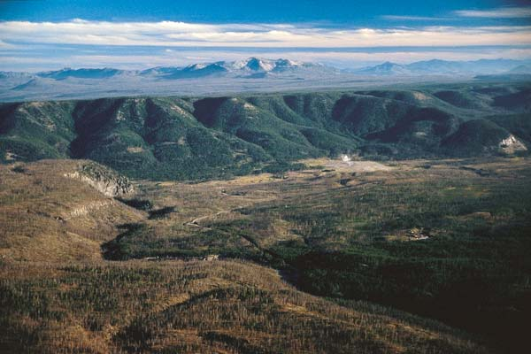
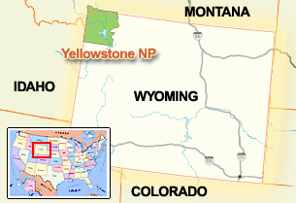
Where is Yellowstone?
Notes:
Yellowstone lies partially in three states -- Montana, Idaho and Wyoming.
Much of Yellowstone is a large crater (a “caldera”) that is surrounded by cliffs. The cliffs are topped by lava flows. This picture was taken from the top of a lava flow. The green bluffs below the mountains are the rim of the caldera. In the foreground are two lava flows.
Photo by Bob Smith, University of Utah. Accessed from National Science Foundation: Discovery. “Yellowstone Rising.” http://www.nsf.gov/discoveries/disc_images.jsp?cntn_id=110651&org=NSF Retrieved 27 December 2011.
Map from National Park Service: “Yellowstone Location Map.” http://www.nps.gov/features/yell/interactivemap/yelllocationmap.htm Retrieved 27 December 2011.

Slide 3
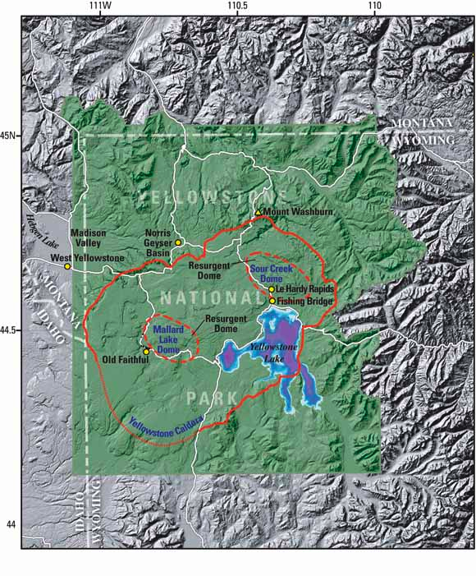
What is Yellowstone?
Exploring the landscape
Notes:
This image shows that the region is mountainous, but there is more subdued topography within most of the national park. The Yellowstone caldera, 640,000 years old, appears as a red-orange line. Where the line is thinner, geologists can only infer the caldera boundary. Volcanic material has filled the caldera and smoothed out the topography. Two later episodes of volcanism pushed up domes within the caldera: the Mallard Lake Dome and Sour Creek Dome.
The squiggly white lines are paved roads.
If you are doing this assignment with a paper map and transparent overlays instead of Google Earth, this map or the one on the next slide could serve as your base map. Your team of three experts will need to decide which map you will use. If you are using paper maps, you have a copy of the two maps in your instructions.
Image from USGS Fact Sheet 100-03. 2004. “Tracking Changes in Yellowstone‘s Restless Volcanic System.” http://pubs.usgs.gov/fs/fs100-03/index.html#yellowstone_fig2 Retrieved 27 December 2011.

Slide 4
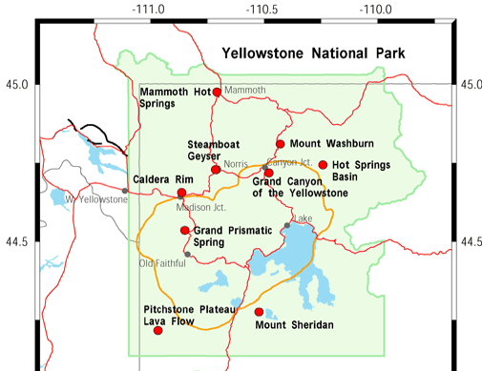
What is Yellowstone?
Exploring the landscape
Notes:
This map of Yellowstone shows roads as red lines and the location of the most recent caldera as a gold line. The park is the green area.
Red dots are links to photos and information about the park from the Yellowstone – Teton Epicenter’s “Location Map.”
By clicking anywhere on the slide, you will open the webpage with live links on the red dots. http://www.yellowstonegis.utah.edu/maps/index.html. (Search for “yellowstone gis epicenter” and choose the maps link.
Image from Yellowstone – Teton Epicenter: “Location Map.” http://www.yellowstonegis.utah.edu/maps/index.html Retrieved 28 December 2011.

Slide 5
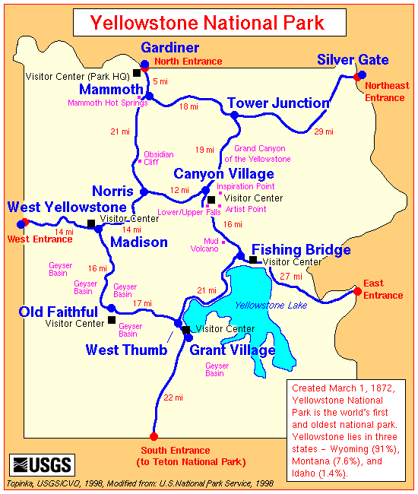
What is Yellowstone?
Cultural and geological features
Notes:
This general map shows where some of the geological and cultural or tourist attractions are. These are where many visitors stop to look at sights, buy supplies, or stay the night. The next map shows more detail.
Map from USGS Cascade Volcano Observatory. http://vulcan.wr.usgs.gov/Imgs/Gif/Yellowstone/Maps/map_yellowstone.gif Retrieved 28 December 2011.

Slide 6
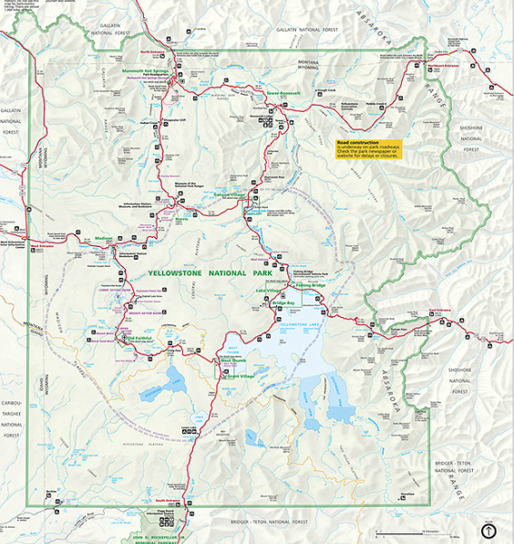
What is Yellowstone?
Cultural and geological features
Notes:
This map shows details that you might want to refer to when learning your part of the geology. It is part of the map/brochure that the National Park Service gives visitors as they enter the park. You can view this map better by clicking anywhere on the map and then being patient….there’s a lot of data to open. http://www.nps.gov/hfc/carto/PDF/YELLmap1.pdf (Search for “Yellowstone detail yellmap1.”)
The base map that you will draw on is a simplified version of this map.
Image from National Park Service: Park Map Viewer. http://www.nps.gov/pwr/customcf/apps/maps/showmap.cfm?alphacode=yell&parkname=yellowstone%20national%20park Retrieved 28 December 2011.

Slide 7
Taking Yellowstone’s Pulse Volcanic eruptions
Notes:
Yellowstone is one of the largest and most active calderas in the world. Eruptions in Yellowstone started about 2.3 million years ago. But, they follow a string of eruptions in the region that has left a path of calderas. Click on this slide and then on “Interactive: A Hotspot Trail” on the webpage to explore an animation of volcanism moving across the region over time. The center of volcanism has moved because the North American plate is moving over a “hotspot” in the mantle that produces magma by melting rocks in the crust. “Mya” stand for “million years ago.” That is when the hotspot was active there. For instance, the McDermitt Volcanic Field had volcanoes erupting 16.1 million years ago.
Between the caldera-forming events (three in Yellowstone), other lava eruptions and hydrothermal eruptions occurred. The topography of the older craters is quite flat because of millions of years of erosion and burial by other volcanic events such as the Snake River Plain flood basalts.
http://www.amnh.org/explore/science-bulletins/earth/documentaries/yellowstone-monitoring-the-fire-below/interactive-a-hotspot-trail (Search for “amnh hotspot trail.”)
Image from Yellowstone’s Photo Collection. “Yellowstone Hot Spot Track.” http://www.nps.gov/features/yell/slidefile/graphics/diagrams/Images/15899.jpg Retrieved 12 November 2014.

Slide 8
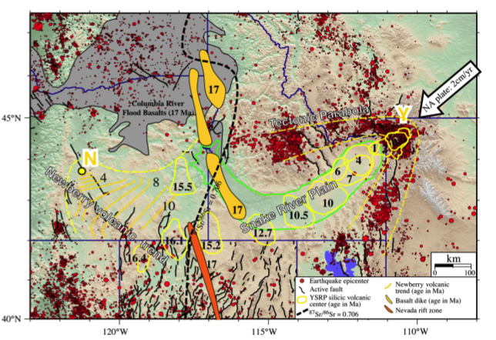
Taking Yellowstone’s Pulse Volcanic eruptions
Notes:
Look for the large yellow and white Y by the big white and black arrow. That is where the Yellowstone hot spot currently lies deep under the surface.
The rest of the map is certainly complicated but it shows the science behind the animation you explored in the previous slide. The black numbers show the ages of volcanic rocks west of Yellowstone in millions of years. 15.5, for instance stand for rocks that are 15.5 million years old.
The red dots show where earthquakes were first felt on Earth’s surface (the “epicenters.”) Look at the legend to see what the other symbols represent.
This figure compiles the work of many geologists and is published in a scientific research journal. It’s this kind of article, and the research that goes into it, that allowed the American Museum of Natural History to build the animation you explored on the previous slide.
Figure from Smith, R.B.; Jordan, M.; Steinberger, B.; Puskas, C.M.; Farrell, J.; Waite, G.P.; Husen. S.; Chan, W-L; and O'Connell, R.. 2009. “Geodynamics of the Yellowstone hotspot and mantle plume: Seismic and GPS imaging, kinematics, and mantle ﬂow.” Journal of Volcanology and Geothermal Research. v. 188. pp 26–56. Retrieved 29 December 2011.

Slide 9
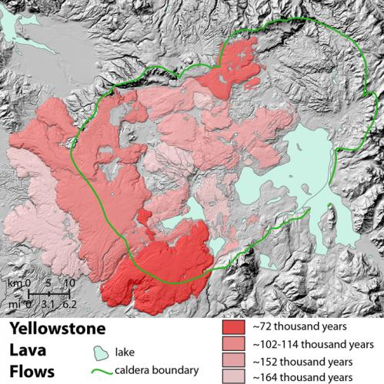
Taking Yellowstone’s Pulse Lava flows
Volcanic rocks erupted after caldera collapsed
Notes:
There have been about 80 lava flows since the most recent caldera formed 640,000 years ago. This map uses color to show different ages of the rocks, both inside and outside the caldera
Clicking on the map links to The American Museum of Natural History’s Science Bulletin. Select the “Different magmas - Different volcano” interactive link on this page to investigate the relationship between the different kinds of lava and volcanoes. http://www.amnh.org/explore/science-bulletins/earth/documentaries/yellowstone-monitoring-the-fire-below/interactive-different-magmas-different-volcanoes (Search for “amnh different magmas.”)
Image from USGS Volcano Hazards Program: Yellowstone Volcano Observatory. Yellowstone maps. http://volcanoes.usgs.gov/volcanoes/yellowstone/yellowstone_gallery_14.html Retrieved 6 November 2014.

Slide 10
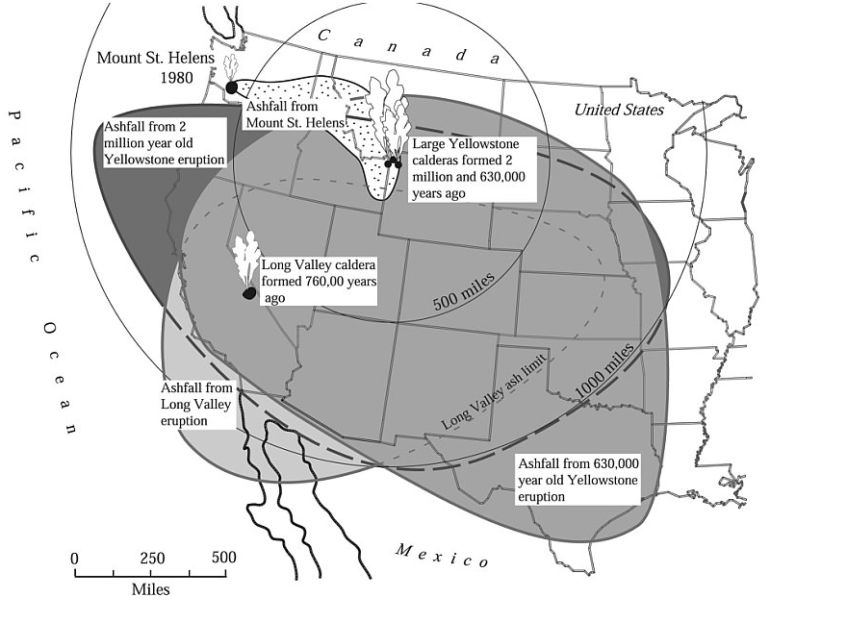
Taking Yellowstone’s Pulse Ash falls
Areas of ash fall
Notes:
The collapse of calderas is cataclysmic. Rocks and lava explode upward and outward as the caldera collapses, and the debris covers huge regions. This map shows how far volcanic ash went during the 2,100,000 and 630,000 year-old eruptions that led to calderas in Yellowstone.
Figure from Smith, R.B. and Seigel, L.J. 2000. Windows into the Earth, The Geologic Story of Yellowstone and Grand Teton National Park. Oxford University Press. Accessed from the Yellowstone Volcano Observatory. http://volcanoes.usgs.gov/yvo/images/2000-rbs-3.2volcanicashcover_large.jpg Retrieved 30 December 2011.

Slide 11
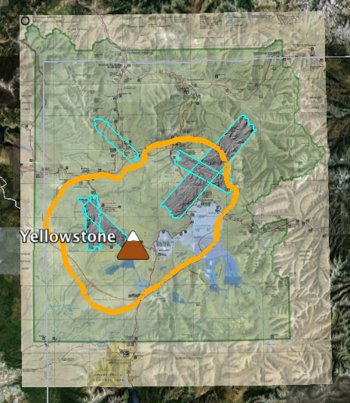
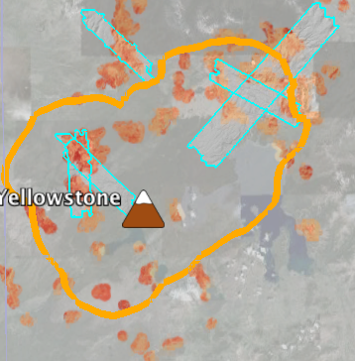
Taking Yellowstone’s Pulse Volcanic features
Volcanic features in Google Earth
Notes:
If your team will be using Google Earth (GE) to compare where the interesting features in the park are, you might want to become familiar with your data on GE now. These two images were made with GE. The left-hand one shows all of the park, with an overlay of the National Park Service map, the caldera in gold, and turquoise outlined areas of high-tech satellite-based topography (LiDAR).
The right-hand image is zoomed in closer. You can see where it’s from by the northwest-southeast trending LiDAR region. This image does not have the official park map showing. It just has the base map, the caldera, LiDAR, and hot areas in orange shades. The heat was measured from NASA’s Landsat satellites from 1985 to 2007. With GE, you can see the changes over time. You’ll be able to add layers and remove them easily in GE.
There is a separate set of instructions which guide you through using Google Earth. Also, we have prepared some files that are ready for you to open in GE. (You can also make your own files from a spreadsheet by following our instructions.) The next slide has links to these files.

Slide 12
Taking Yellowstone’s Pulse Data
Links to data files:
The National Park Service map as an overlay
Satellite images of the ground (LiDAR)
Yellowstone’s caldera
Yellowstone’s hot areas
Links to instructions:
Instructions for using Google Earth
Instructions for converting an Excel spreadsheet into a file for Google Earth
Notes:
Both images were clipped from the a Google Earth map with earthquakes as dots. One of your teammates will be able to supply this data.

Slide 13
Taking Yellowstone’s Pulse Data
Links to instructions:
Instructions for using Google Earth
Instructions for converting an Excel spreadsheet into a file for Google Earth
Notes:
Both images were clipped from the a GE map with earthquakes as dots. One of your teammates will be able to supply this data.

Slide 14
Taking Yellowstone’s Pulse Student resources
Information
EARTH: “Tracking Yellowstone’s Activity”
http://www.earthmagazine.org/article/tracking-yellowstones-activity
(Search for “tracking yellowstone’s activity.”)
“Steam Explosions, Earthquakes, and Volcanic Eruptions—What’s in Yellowstone’s Future?”
http://pubs.usgs.gov/fs/2005/3024/fs2005-3024.pdf (Search for “pdf usgs explosion yellowstone.”)
“Tracking Changes in Yellowstone's Restless Volcanic System”
http://pubs.usgs.gov/fs/fs100-03/ (Search for “tracking changes yellowstone.”)
Notes:
All three sites retrieved 6 November 2014.

Slide 15
Taking Yellowstone’s Pulse Sources
American Museum of Natural History (n.d.) Science Bulletins: “Yellowstone: Monitoring the Fire Below, “Signs of Restlessness.” http://www.amnh.org/explore/science-bulletins/earth/documentaries/yellowstone-monitoring-the-fire-below/article-signs-of-restlessness (Search for “amnh signs restlessness.”)
Christensen, R. et. al.2007. USGS: Open-file Report 2007-1071. “Preliminary Assessment of Volcanic and Hydrothermal Hazards in Yellowstone National Park and Vicinity.“ http://pubs.usgs.gov/of/2007/1071/ (Search for “preliminary volcanic hydrothermal hazards yellowstone.”)
Dzurisin, D.; Savage, J.C.; and Fournier, R.O. 1990. “Recent crustal subsidence at Yellowstone Caldera, Wyoming.” Bulletin of Volcanology, v. 52, p. 247-270. accessed from Yellowstone Volcano Observatory,“ Leveling Data Across Yellowstone Caldera.” http://pubs.er.usgs.gov/publication/70016303 (Search for “recent subsidence at yellowstone.”)
Puckas, C.; Smith, R; Meertens, C.; and Chang, W-L. 2007. “Crustal deformation of the Yellowstone-Snake River Plain volcano-tectonic system: Campaign and continuous GPS observations, 1987-2004.” Journal of Geophysical Research, v. 112. http://volcanoes.usgs.gov/yvo/2007/PuskasJGR.pdf (Search for “Puskas deformation yellowstone-snake river.”)
USGS. 2010. Yellowstone Volcano Observatory. “Volcano Monitoring at Yellowstone National Park” http://volcanoes.usgs.gov/yvo/activity/monitoring/index.php (Search for “YVO monitoring.”)
USGS. 2008. Yellowstone Volcano Observatory. “Recent ups and downs of Yellowstone Caldera.” http://volcanoes.usgs.gov/yvo/publications/2007/upsanddowns.php (Search for “ups downs yellowstone.”)
USGS. 2005. U.S. Geological Survey Fact Sheet 2005-3024: “Steam Explosions, Earthquakes, and Volcanic Eruptions--What’s in Yellowstone’s Future?” http://pubs.usgs.gov/fs/2005/3024/ (Search for “usgs steam explosions yellowstone.”)
USGS. 2004. U.S. Geological Survey Fact Sheet 100-03: “Tracking Changes in Yellowstone’s Restless Volcanic System.” http://pubs.usgs.gov/fs/fs100-03/ (Search for “tracking changes yellowstone.”)
Notes:
All retrieved 6 November 2014.

